Slide 1
MASTERS IN PROJECT MANAGEMENT
PROJECT RISK
MANAGEMENT
Class: MS(PM)-2(A,B&C)

Slide 2
Instructor
Suhail Iqbal
PE, PMP, PgMP, PME, MCT, PRINCE2 Practitioner.
PE, PMP, PgMP, PME, MCT, PRINCE2 Practitioner.
Notes:
Custom animation effects: horizontal scrolling text
(Basic)
To reproduce the text effects on this slide, do the following:
On the Home tab, in the Slides group, click Layout, and then click Blank.
On the Insert tab, in the Text group, click Text Box, and then on the slide, drag to draw the text box.
Enter text in the text box. (Note: You may want to add a bullet point at the end of your text, as in the example above. On the Insert tab, in the Text group, click Symbol. In the Symbol dialog box, in the Font list, select (normal text). In the Subset list, select General Punctuation. In the Character Code box, enter 2022 to select BULLET, and then click Insert.)
Select the text. On the Home tab, in the Font group, do the following:
In the Font list, select Gill Sans MT.
In the Font Size list, select 36.
Click Bold.
Click the arrow next to Font Color, and then under Theme Colors click White, Background 1 (first row, first option from the left).
On the Home tab, in the Paragraph group, click Align Text Left to align the text left in the text box. (Note: If the text wraps to more than one line, drag the adjustment handles on the text box to widen it until the text fits on one line.)
Drag the text box to the left of the lower left edge of the slide. (Note: To see beyond the edges of the slide, on the View tab, click Zoom, and then in the Zoom dialog box, in the Percent box, enter 40%.)
To reproduce the animation effects on this slide, do the following:
On the Animations tab, in the Animations group, click Custom Animation.
On the slide, select the text box. In the Custom Animation task pane, do the following:
Click Add Effect, point to Entrance, and then click More Effects. In the Add Entrance Effect dialog box, under Basic, click Fly In.
Select the animation effect (fly-in effect for the text box). Click the arrow to the right of the select effect, and then click Effect Options. In the Fly In dialog box, do the following:
On the Effect tab, in the Direction list, select From Right.
On the Timing tab, do the following:
In the Start list, select With Previous.
In the Speed box, enter 16 seconds.
In the Repeat list, select Until End of Slide.
On the slide, select the text box. On the Home tab, in the Clipboard group, click the arrow under Paste, and then click Duplicate.
In the Custom Animation task pane, select the second animation effect (fly-in effect for the second text box). Click the arrow to the right of the selected effect, and then click Timing. In the Fly In dialog box, on the Timing tab, in the Delay box, enter 8. (Note: You may need to adjust the delay time if the length of your text is different than the example above.)
On the slide, drag the second text box on top of the first text box.
On the Home tab, in the Editing group, click Select, and then click Selection Pane.
In the Selection and Visibility pane, press and hold CTRL, and then select both text boxes. On the Home tab, in the Drawing group, click Arrange, point to Align, and then do the following:
Click Align Selected Objects.
Click Align Middle.
Click Align Center.
To reproduce the background effects on this slide, do the following:
Right-click the slide background area, and then click Format Background. In the Format Background dialog box, click Fill in the left pane, and then select Picture or texture fill in the Fill pane. Under Insert from, click File. In the Insert Picture dialog box, select a picture, and then click Insert.
On the Home tab, in the Drawing group, click Shapes, and then under Rectangles click Rectangle (first option from the left). On the slide, drag to draw a rectangle.
Select the rectangle. Under Drawing Tools, on the Format tab, in the Size group, do the following:
In the Shape Height box, enter 7.5”.
In the Shape Width box, enter 1”.
Under Drawing Tools, on the Format tab, in the Shape Styles group, click the arrow next to Shape Outline, and then click No Outline.
On the Home Tab, in the Drawing group, click the arrow next to Shape Fill, point to Gradient, and then click More Gradients. In the Format Shape dialog box, click Fill in the left pane, select Gradient fill in the Fill pane, and then do the following:
In the Type list, select Linear.
Click the button next to Direction, and then click Linear Right (first row, fourth option from the left).
Under Gradient stops, click Add or Remove until two stops appear in the drop-down list.
Also under Gradient stops, customize the gradient stops that you added as follows:
Select Stop 1 from the list, and then do the following:
In the Stop position box, enter 0%.
Click the button next to Color, and then under Theme Colors click Black, Text 1 (first row, second option from the left).
In the Transparency box, enter 0%.
Select Stop 2 from the list, and then do the following:
In the Stop position box, enter 100%.
Click the button next to Color, and then under Theme Colors click Black, Text 1, (first row, second option from the left).
In the Transparency box, enter 100%.
On the slide, select the rectangle. On the Home tab, in the Drawing group, click Arrange, point to Align, and then do the following:
Click Align to Slide.
Click Align Left.
Click Align Middle.
Select the rectangle. On the Home tab, in the Clipboard group, click the arrow under Paste, and then click Duplicate.
Select the duplicate rectangle. On the Home Tab, in the Drawing group, click the arrow next to Shape Fill, point to Gradient, and then click Linear Left (second row, third option from the left).
With the duplicate rectangle still selected, on the Home tab, in the Drawing group, click Arrange, point to Align, and then do the following:
Click Align to Slide.
Click Align Right.
Click Align Middle.

Slide 3
SYLLABUS
Unit | Content | Learning Objectives
9. Perform Quantitative Risk Analysis | Purpose and Objective of the Perform Quantitative Risk Analysis Process Critical Success Factors for the Perform Quantitative Risk Analysis Process Tools & Techniques for the Perform Quantitative Risk Analysis Process Documenting the Results of the Perform Quantitative Risk Analysis Process | Understand the process of in-depth analysis or Quantitative Risk Analysis of only those risks shortlisted from earlier process. Perform Quantitative Risk Analysis using various Quantitative Risk Analysis Tools & Techniques and Documenting the Results.

Slide 4
UNIT 8
UNIT 9
PERFORM QUANTITATIVE RISK analysis
PROJECT RISK
MANAGEMENT
Class: MS(PM)-2 (A,B&C)

Slide 5
PERFORM QUANTITATIVE RISK ANALYSIS
LEARNING OBJECTIVE
UNIT 9
Understand the process of in-depth analysis or Quantitative Risk Analysis of only those risks shortlisted from earlier process. Perform Quantitative Risk Analysis using various Quantitative Risk Analysis Tools & Techniques and Documenting the Results.

Slide 6
PERFORM QUANTITATIVE RISK ANALYSIS
CONTENT
UNIT 9
Purpose and Objective of the Perform Quantitative Risk Analysis Process
Critical Success Factors for the Perform Quantitative Risk Analysis Process
Tools & Techniques for the Perform Quantitative Risk Analysis Process
Documenting the Results of the Perform Quantitative Risk Analysis Process

Slide 7
UNIT 8
PERFORM QUANTITATIVE RISK ANALYSIS
Purpose and Objectives

Slide 8
PERFORM QUANTITATIVE RISK ANALYSIS
Purpose and Objectives
Numerical Estimate
UNIT 9
The Perform Quantitative Risk Analysis process provides a numerical estimate of the overall effect of risk on the objectives of the project, based on current plans and information., when considering risks simultaneously.
Results from this type of analysis can be used to evaluate the likelihood of success in achieving project objectives and to estimate contingency reserves, usually for time and cost that are appropriate to both the risks and the risk response of project stakeholders.
From Practice Standard for Project Risk Management, 1st Ed, PMI

Slide 9
PERFORM QUANTITATIVE RISK ANALYSIS
Purpose and Objectives
More Realism
UNIT 9
It is generally accepted that analyzing uncertainty in the project using quantitative techniques such as Monte Carlo simulation may provide more realism in the estimate of the overall project cost or schedule than a non-probabilistic approach which assumes that the activity durations or line-item cost estimates are deterministic.
However it should be recognized that quantitative risk analysis is not always required or appropriate for all projects.
From Practice Standard for Project Risk Management, 1st Ed, PMI

Slide 10
PERFORM QUANTITATIVE RISK ANALYSIS
Purpose and Objectives
Justify Additional Effort
UNIT 9
Qualitative risk analysis may provide enough information for development of effective risk responses, especially for smaller projects.
During the Plan Risk Management process, the benefits of quantitative risk analysis should be weighed against the effort required to ensure that the additional insights and value justify the additional effort.
From Practice Standard for Project Risk Management, 1st Ed, PMI

Slide 11
PERFORM QUANTITATIVE RISK ANALYSIS
Purpose and Objectives
Overall Project Risk
UNIT 9
Partial risk analysis, such as qualitative risk analysis, aim at prioritizing individual risks viewed one at a time and therefore cannot produce measures of overall project risk when all risks are considered simultaneously.
Calculating estimates of overall project risks is the focus of the Perform Quantitative Risk Analysis process.
From Practice Standard for Project Risk Management, 1st Ed, PMI

Slide 12
PERFORM QUANTITATIVE RISK ANALYSIS
Purpose and Objectives
Project Objectives
UNIT 9
Specific project risks are usually best understood and quantified at a detailed level such as the lime-item cost or schedule activity level.
By contrast, project objectives such as achievement of the project’s budget or the schedule are specified at a higher level, often at the level of the total project.
An overall risk analysis, such as one that uses quantitative techniques, estimates the implication of all quantified risks on project objectives.
From Practice Standard for Project Risk Management, 1st Ed, PMI

Slide 13
PERFORM QUANTITATIVE RISK ANALYSIS
Purpose and Objectives
Method Implementation requires:
UNIT 9
Complete and accurate representation of the project objectives built up from individual project elements. e.g., project schedule or cost estimate.
Identifying risks on individual project elements such as schedule activities or line-item costs at a level of detail that lends itself to specific assessment of individual risks.
Including generic risks that have a broader effect than individual project elements.
Applying a quantitative method (Monte Carlo simulation or decision tree analysis) that incorporates multiple risks simultaneously in determining overall impact on the overall project objective.
From Practice Standard for Project Risk Management, 1st Ed, PMI

Slide 14
PERFORM QUANTITATIVE RISK ANALYSIS
Purpose and Objectives
Answers following questions:
UNIT 9
Results will be compared to project plan (baseline or current) to give management an estimate of the overall project risk and will answer important questions such as:
What is the probability of meeting the project’s objectives?
How much contingency reserve (e.g., reserves or buffers of time, resources, and cost) is needed to provide the organization with the level of certainty it requires based upon its risk tolerance?
What are those parts of the project, such as line-item costs or schedule activities, which contribute the most risk when all risks are considered simultaneously?
Which individual risks contribute the most to overall project risk?
From Practice Standard for Project Risk Management, 1st Ed, PMI

Slide 15
PERFORM QUANTITATIVE RISK ANALYSIS
Purpose and Objectives
Stakeholder Tolerance
UNIT 9
Estimating overall project risk using quantitative methods helps distinguish those projects where quantified risks threaten objectives beyond the tolerance of the stakeholders, from those for which the objectives are within acceptable tolerances even when risk is considered.
The former may be targeted for vigorous risk responses aimed at protecting those objectives most important to the stakeholders.
From Practice Standard for Project Risk Management, 1st Ed, PMI

Slide 16
PERFORM QUANTITATIVE RISK ANALYSIS
A COMPARISON
From Practice Standard for Project Risk Management, 1st Ed, PMI

Slide 17
PERFORM QUANTITATIVE RISK ANALYSIS
Objectives
UNIT 9
Decide which risks warrant a response.
Objectively evaluate the probability and impact of each risk.
Determine the level of risk the project currently has and whether that level of risk is acceptable for the expected gain from the product of the project.
Determine how much the project will cost and how long it will take if no further risk management actions are taken to decrease project risk.
Determine which risks require response planning.
Determine the probability of achieving cost or schedule objectives for the project.
From Rita Mulcahy’s Risk Management – Tricks of the Trade for Project Managers, and PMI-RMP® Exam Prep Guide, 2nd Ed

Slide 18
PERFORM QUANTITATIVE RISK ANALYSIS
Inputs
UNIT 9
Risk Management Plan
Risk Register, which currently includes:-
Prioritized risks from Perform Qualitative Risk Analysis process
List of risks carried forward for additional analysis
Historical records: how were similar risks quantified in the past.
Outputs from other parts of project planning, including the cost management plan, and schedule management plan.
From Rita Mulcahy’s Risk Management – Tricks of the Trade for Project Managers, and PMI-RMP® Exam Prep Guide, 2nd Ed

Slide 20
8
2
Perform Qualitative Risk Analysis
Risk
Planning
Process 11.3
Process of prioritizing risks for further analysis or action by assessing and combining their probability of occurrence and impact.
11.3
Inputs
1
Tools and Techniques
2
Outputs
3
Risk Register
Risk Management Plan
Project Scope Statement
Organizational Process Assets
____________
Risk Probability and Impact Assessment
Probability and Impact Matrix
Risk Data Quality Assessment
Risk Categorization
Risk Urgency Assessment
Expert Judgment
___________
Risk Register Updates
____________
Reference: Figure 11.8.
PMBOK® Guide, 4th Ed
Notes:
Picture with three text columns
(Intermediate)
To reproduce the picture effects on this slide, do the following:
On the Home tab, in the Slides group, click Layout, and then click Blank.
On the Insert tab, in the Illustrations group, click Picture.
In the Insert Picture dialog box, select a picture and then click Insert.
Select the picture. Under Picture Tools, on the Format tab, in the bottom right corner of the Size group, click the Size and Position dialog box launcher.
In the Size and Position dialog box, on the Size tab, resize or crop the picture as needed so that under Size and rotate, the Height box is set to 1.48” and the Width box is set to 9.17”. Resize the picture under Size and rotate by entering values into the Height and Width boxes. Crop the picture under Crop from by entering values into the Left, Right, Top, and Bottom boxes.
On the Home tab, in the bottom right corner of the Drawing group, click the Format Shape dialog box launcher. In the Format Shape dialog box, click Line Color in the left pane, select Gradient line in the right pane, and then do the following:
In the Type list, select Linear.
Click the button next to Direction, and then click Linear Up (second row, second option from the left).
Under Gradient stops, click Add or Remove until two stops appear in the drop-down list.
Also under Gradient stops, customize the gradient stops that you added as follows:
Select Stop 1 from the list, and then do the following:
In the Stop position box, enter 0%.
Click the button next to Color, and then under Theme Colors click White, Background 1 (first row, first option from the left).
Select Stop 2 from the list, and then do the following:
In the Stop position box, enter 100%.
Click the button next to Color, and then under Theme Colors click White, Background 1, Darker 25% (fourth row, first option from the left).
Also in the Format Shape dialog box, click Line Style in the left pane, and then in the right pane, in the Width box, enter 1 pt.
On the Home tab, in the Drawing group, click Shape Effects, point to Glow, and then do the following:
Under Glow Variations, select any option in the first row (5 pt glow options).
Point to More Glow Colors, and then under Theme Colors click White, Background 1, Darker 25% (fourth row, first option from the left).
On the Home tab, in the Drawing group, click Arrange, point to Align, and then click Align Center.
To reproduce the first column heading on this slide, do the following:
On the Home tab, in the Drawing group, click Shapes, and then under Rectangles, click Rectangle (first option from the left). On the slide, drag to draw a rectangle.
Under Drawing Tools, on the Format tab, in the Size group, do the following:
In the Shape Height box, enter 1”.
In the Shape Width box, enter 2.92”.
On the Home tab, in the bottom right corner of the Drawing group, click the Format Shape dialog box launcher. In the Format Shape dialog box, click Fill in the left pane, select Gradient fill in the right pane, and then do the following:
In the Type list, select Linear.
Click the button next to Direction, and then click Linear Down (first row, second option from the left).
Under Gradient stops, click Add or Remove until two stops appear in the drop-down list.
Also under Gradient stops, customize the gradient stops that you added as follows:
Select Stop 1 from the list, and then do the following:
In the Stop position box, enter 32%.
Click the button next to Color, and then under Theme Colors click Tan, Background 2 (first row, third option from the left).
Select Stop 2 from the list, and then do the following:
In the Stop position box, enter 100%.
Click the button next to Color, and then under Theme Colors click Tan, Background 2, Darker 25% (third row, third option from the left).
Also in the Format Shape dialog box, click Line Color in the left pane, select Gradient line in the Line Color pane, and then do the following:
In the Type list, select Linear.
Click the button next to Direction, and then click Linear Up (second row, second option from the left).
Under Gradient stops, click Add or Remove until two stops appear in the drop-down list.
Also under Gradient stops, customize the gradient stops that you added as follows:
Select Stop 1 from the list, and then do the following:
In the Stop position box, enter 0%.
Click the button next to Color, and then under Theme Colors click White, Background 1 (first row, first option from the left).
Select Stop 2 from the list, and then do the following:
In the Stop position box, enter 100%.
Click the button next to Color, and then under Theme Colors click White, Background 1, Darker 25% (fourth row, first option from the left).
Also in the Format Shape dialog box, click Line Style in the left pane. In the right pane, in the Width box, enter 1 pt.
On the Home tab, in the Drawing group, click Shape Effects, point to Glow, and then do the following:
Under Glow Variations, select any option in the first row (5 pt glow options).
Point to More Glow Colors, and then under Theme Colors click White, Background 1, Darker 25% (fourth row, first option from the left).
On the slide, right-click the rectangle and then click Edit Text.
Enter text in the text box and select the text. On the Home tab, in the Font group, select Gill Sans MT from the Font list and then select 24 from the Font Size list.
On the Home tab, in the Paragraph group, click Align Text Left to align the text left within the text box.
Under Drawing Tools, on the Format tab, in the WordArt Styles group, click the arrow next to Text Fill, and then under Theme Colors click Tan, Background 2, Darker 75% (fifth row, third option from the left).
On the Home tab, in the bottom-right corner of the Drawing group, click the Format Shapes dialog box launcher. In the Format Shapes dialog box, click Text Box in the left pane. In the right pane, under Internal margin, enter 1” in the Left box to increase the left margin in the rectangle to accommodate the embossed number.
On the Home tab, in the Drawing group, click Shapes, and then under Lines, click Line (first option from the left).
Press and hold SHIFT, and then on the slide, drag to draw a straight, vertical line.
Under Drawing Tools, on the Format tab, in the Size group, in the Width box, enter 0.75”.
On the Home tab, in the bottom-right corner of the Drawing group, click the Format Shapes dialog box launcher. In the Format Shapes dialog box, click Line Style in the left pane, and then do the following in the right pane:
In the Width box, enter 2.25 pt.
Click the button next to Dash type, and then click Round Dot (second option from the top).
Also in the Format Shapes dialog box, click Line Color in the left pane. In the right pane, click the button next to Color, and then under Theme Colors click White, Background 1 (first row, first option from the left).
On the slide, drag the line onto the rectangle, just left of the text box.
On the Insert tab, in the Text box, click Text Box and then on the slide, drag to draw another text box.
Enter 1 in the text box and select the text. On the Home tab, in the Font group, select Calisto MT from the Font list and then enter 50 in the Font Size box.
On the Home tab, in the Paragraph group, click Center to center the text within the text box.
Under Drawing Tools, on the Format tab, in the WordArt Styles group, click the arrow next to Text Fill, and then under Theme Colors click Tan, Background 2, Darker 25% (third row, third option from the left).
Drag the text box onto the rectangle, left of the dotted vertical line.
On the Home tab, in the Editing group, click Select, and then click Selection Pane.
In the Selection and Visibility pane, press and hold CTRL to select the text box, line, and rectangle.
On the Home tab, in the Drawing group, click Arrange, point to Align, and then click Align Middle.
To reproduce the other column headings on this slide, do the following:
On the Home tab, in the Editing group, click Select, and then click Selection Pane.
In the Selection and Visibility pane, press and hold CTRL to select the text box, line, and rectangle.
On the Home tab, in the Drawing group, click Arrange, and then under Group Objects click Group.
On the Home tab, in the Clipboard group, click the arrow under Paste, and then click Duplicate. Repeat the process until you have a total of three groups of shapes.
Select each group in the Selection and Visibility pane and drag it on the slide to form a row under the picture.
Also in the Selection and Visibility pane, press and hold CTRL and select all three groups. On the Home tab, in the Drawing group, click Arrange, point to Align, and then do the following:
Click Align Middle.
Click Distribute Horizontally.
To change the numbers in the duplicate text boxes (second and third from the left), click in each text box and edit the text.
To reproduce the first column (the “subtext” portion) on this slide, do the following:
On the Home tab, in the Drawing group, click Shapes, and then under Rectangles click Rectangle (first option from the left).
On the slide, drag to draw the rectangle so that the top edge is just below the first column heading and the bottom edge is at the bottom of the slide.
Under Drawing Tools, on the Format tab, in the Size group, in the Shape Width box, enter 2.92” so that the subtext column is the same width as the column heading above it.
On the Home tab, in the Drawing group, click the arrow next to Shape Outline, and then click No Outline.
On the Home tab, in the bottom right corner of the Drawing group, click the Format Shape dialog box launcher. In the Format Shape dialog box, click Fill in the left pane, select Gradient fill in the right pane, and then do the following:
In the Type list, select Linear.
Click the button next to Direction, and then click Linear Down (first row, second option from the left).
Under Gradient stops, click Add or Remove until three stops appear in the drop-down list.
Also under Gradient stops, customize the gradient stops that you added as follows:
Select Stop 1 from the list, and then do the following:
In the Stop position box, enter 0%.
Click the button next to Color, and then under Theme Colors click White, Background 1 (first row, first option from the left).
In the Transparency box, enter 100%.
Select Stop 2 from the list, and then do the following:
In the Stop position box, enter 50%.
Click the button next to Color, and then under Theme Colors click Tan, Background 2, Darker 25% (third row, third option from the left).
In the Transparency box, enter 25%.
Select Stop 3 from the list, and then do the following:
In the Stop position box, enter 100%.
Click the button next to Color, and then under Theme Colors click White, Background 1 (first row, first option from the left).
In the Transparency box, enter 100%.
On the slide, right-click the column and then click Edit Text.
Enter text in the text box and select the text. On the Home tab, in the Font group, select Gill Sans MT from the Font list and then enter 22 in the Font Size box.
On the Home tab, in the Paragraph group, click Center to center the text within the rectangle.
Under Drawing Tools, on the Format tab, in the WordArt Styles group, click the arrow next to Text Fill, and then under Theme Colors click White, Background 1, Darker 50% (sixth row, first option from the left).
On the Home tab, in the bottom-right corner of the Drawing group, click the Format Shapes dialog box launcher. In the Format Shapes dialog box, click Text Box in the left pane. In the right pane, under Text layout, in the Vertical Alignment list, select Top.
To reproduce the other columns (the “subtext” portion) on this slide, do the following:
Select the first “subtext” rectangle. On the Home tab, in the Clipboard group, click the arrow under Paste, and then click Duplicate. Repeat the process until you have a total of three “subtext” rectangles.
Drag each duplicate on the slide to form a row under the “text heading” rectangles.
Press and hold SHIFT and select all three “subtext” rectangles. On the Home tab, in the Drawing group, click Arrange, point to Align, and then click Distribute Horizontally.
To reproduce the background on this slide, do the following:
Right-click the slide background area, and then click Format Background. In the Format Background dialog box, click Fill in the left pane, select Gradient fill in the right pane, and then do the following:
In the Type list, select Radial.
Click the button next to Direction, and then click From Center (third option from the left).
Under Gradient stops, click Add or Remove until two stops appear in the drop-down list.
Also under Gradient stops, customize the gradient stops that you added as follows:
Select Stop 1 from the list, and then do the following:
In the Stop position box, enter 0%.
Click the button next to Color, and then under Theme Colors click White, Background 1 (first row, first option from the left).
Select Stop 2 from the list, and then do the following:
In the Stop position box, enter 100%.
Click the button next to Color, and then under Theme Colors click Tan, Background 2 (first row, third option from the left).

Slide 21
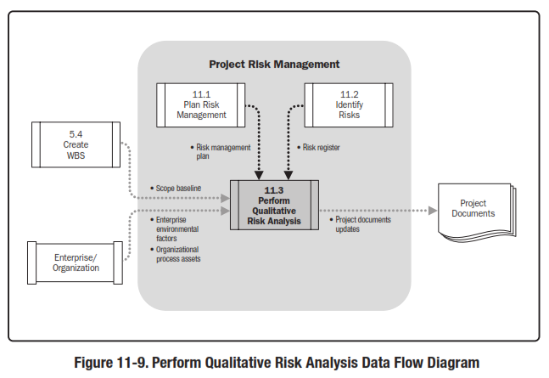
Perform Qualitative Risk Analysis
Reference: Figure 11.9.
PMBOK® Guide, 5th Ed

Slide 22
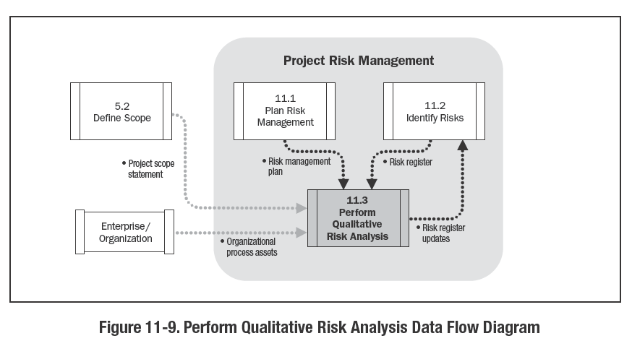
Reference: Figure 11.9.
PMBOK® Guide, 4th Ed

Slide 23
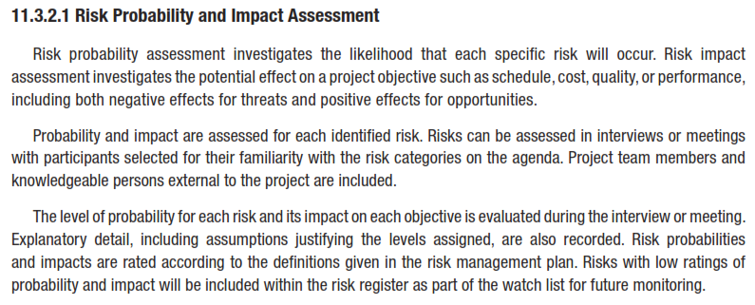
RISK PROBABILITY
AND
IMPACT ASSESSMENT

Slide 24
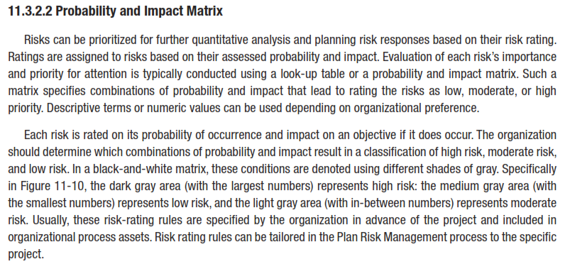
PROBABILITY
AND
IMPACT MATRIX

Slide 25
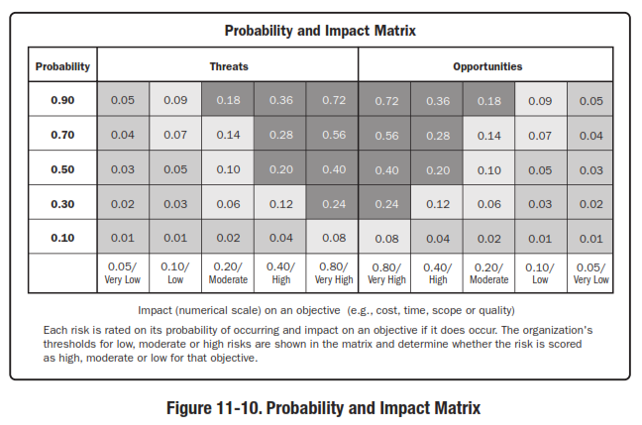
PROBABILITY AND IMPACT MATRIX

Slide 26
RISK DATA QUALITY ASSESSMENT

Slide 27
RISK CATEGORIZATION

Slide 28
RISK URGENCY ASSESSMENT

Slide 29
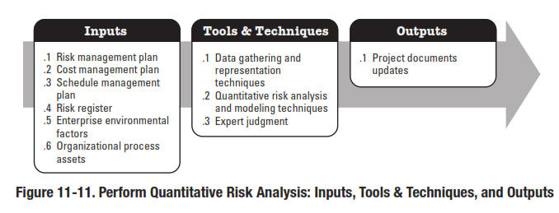
Perform Quantitative Risk Analysis

Slide 30
8
2
Perform Quantitative Risk Analysis
Risk
Planning
Process 11.4
Process of numerically analyzing the effect of identified risks on overall project objectives.
11.4
Inputs
1
Tools and Techniques
2
Outputs
3
Risk Register
Risk Management Plan
Cost Management Plan
Schedule Management Plan
Organizational Process Assets
____________
Data Gathering and Representation Techniques
Quantitative Risk Analysis and Modeling Techniques
Expert Judgment
___________
Risk Register Updates
____________
Reference: Figure 11.11.
PMBOK® Guide, 4th Ed
Notes:
Picture with three text columns
(Intermediate)
To reproduce the picture effects on this slide, do the following:
On the Home tab, in the Slides group, click Layout, and then click Blank.
On the Insert tab, in the Illustrations group, click Picture.
In the Insert Picture dialog box, select a picture and then click Insert.
Select the picture. Under Picture Tools, on the Format tab, in the bottom right corner of the Size group, click the Size and Position dialog box launcher.
In the Size and Position dialog box, on the Size tab, resize or crop the picture as needed so that under Size and rotate, the Height box is set to 1.48” and the Width box is set to 9.17”. Resize the picture under Size and rotate by entering values into the Height and Width boxes. Crop the picture under Crop from by entering values into the Left, Right, Top, and Bottom boxes.
On the Home tab, in the bottom right corner of the Drawing group, click the Format Shape dialog box launcher. In the Format Shape dialog box, click Line Color in the left pane, select Gradient line in the right pane, and then do the following:
In the Type list, select Linear.
Click the button next to Direction, and then click Linear Up (second row, second option from the left).
Under Gradient stops, click Add or Remove until two stops appear in the drop-down list.
Also under Gradient stops, customize the gradient stops that you added as follows:
Select Stop 1 from the list, and then do the following:
In the Stop position box, enter 0%.
Click the button next to Color, and then under Theme Colors click White, Background 1 (first row, first option from the left).
Select Stop 2 from the list, and then do the following:
In the Stop position box, enter 100%.
Click the button next to Color, and then under Theme Colors click White, Background 1, Darker 25% (fourth row, first option from the left).
Also in the Format Shape dialog box, click Line Style in the left pane, and then in the right pane, in the Width box, enter 1 pt.
On the Home tab, in the Drawing group, click Shape Effects, point to Glow, and then do the following:
Under Glow Variations, select any option in the first row (5 pt glow options).
Point to More Glow Colors, and then under Theme Colors click White, Background 1, Darker 25% (fourth row, first option from the left).
On the Home tab, in the Drawing group, click Arrange, point to Align, and then click Align Center.
To reproduce the first column heading on this slide, do the following:
On the Home tab, in the Drawing group, click Shapes, and then under Rectangles, click Rectangle (first option from the left). On the slide, drag to draw a rectangle.
Under Drawing Tools, on the Format tab, in the Size group, do the following:
In the Shape Height box, enter 1”.
In the Shape Width box, enter 2.92”.
On the Home tab, in the bottom right corner of the Drawing group, click the Format Shape dialog box launcher. In the Format Shape dialog box, click Fill in the left pane, select Gradient fill in the right pane, and then do the following:
In the Type list, select Linear.
Click the button next to Direction, and then click Linear Down (first row, second option from the left).
Under Gradient stops, click Add or Remove until two stops appear in the drop-down list.
Also under Gradient stops, customize the gradient stops that you added as follows:
Select Stop 1 from the list, and then do the following:
In the Stop position box, enter 32%.
Click the button next to Color, and then under Theme Colors click Tan, Background 2 (first row, third option from the left).
Select Stop 2 from the list, and then do the following:
In the Stop position box, enter 100%.
Click the button next to Color, and then under Theme Colors click Tan, Background 2, Darker 25% (third row, third option from the left).
Also in the Format Shape dialog box, click Line Color in the left pane, select Gradient line in the Line Color pane, and then do the following:
In the Type list, select Linear.
Click the button next to Direction, and then click Linear Up (second row, second option from the left).
Under Gradient stops, click Add or Remove until two stops appear in the drop-down list.
Also under Gradient stops, customize the gradient stops that you added as follows:
Select Stop 1 from the list, and then do the following:
In the Stop position box, enter 0%.
Click the button next to Color, and then under Theme Colors click White, Background 1 (first row, first option from the left).
Select Stop 2 from the list, and then do the following:
In the Stop position box, enter 100%.
Click the button next to Color, and then under Theme Colors click White, Background 1, Darker 25% (fourth row, first option from the left).
Also in the Format Shape dialog box, click Line Style in the left pane. In the right pane, in the Width box, enter 1 pt.
On the Home tab, in the Drawing group, click Shape Effects, point to Glow, and then do the following:
Under Glow Variations, select any option in the first row (5 pt glow options).
Point to More Glow Colors, and then under Theme Colors click White, Background 1, Darker 25% (fourth row, first option from the left).
On the slide, right-click the rectangle and then click Edit Text.
Enter text in the text box and select the text. On the Home tab, in the Font group, select Gill Sans MT from the Font list and then select 24 from the Font Size list.
On the Home tab, in the Paragraph group, click Align Text Left to align the text left within the text box.
Under Drawing Tools, on the Format tab, in the WordArt Styles group, click the arrow next to Text Fill, and then under Theme Colors click Tan, Background 2, Darker 75% (fifth row, third option from the left).
On the Home tab, in the bottom-right corner of the Drawing group, click the Format Shapes dialog box launcher. In the Format Shapes dialog box, click Text Box in the left pane. In the right pane, under Internal margin, enter 1” in the Left box to increase the left margin in the rectangle to accommodate the embossed number.
On the Home tab, in the Drawing group, click Shapes, and then under Lines, click Line (first option from the left).
Press and hold SHIFT, and then on the slide, drag to draw a straight, vertical line.
Under Drawing Tools, on the Format tab, in the Size group, in the Width box, enter 0.75”.
On the Home tab, in the bottom-right corner of the Drawing group, click the Format Shapes dialog box launcher. In the Format Shapes dialog box, click Line Style in the left pane, and then do the following in the right pane:
In the Width box, enter 2.25 pt.
Click the button next to Dash type, and then click Round Dot (second option from the top).
Also in the Format Shapes dialog box, click Line Color in the left pane. In the right pane, click the button next to Color, and then under Theme Colors click White, Background 1 (first row, first option from the left).
On the slide, drag the line onto the rectangle, just left of the text box.
On the Insert tab, in the Text box, click Text Box and then on the slide, drag to draw another text box.
Enter 1 in the text box and select the text. On the Home tab, in the Font group, select Calisto MT from the Font list and then enter 50 in the Font Size box.
On the Home tab, in the Paragraph group, click Center to center the text within the text box.
Under Drawing Tools, on the Format tab, in the WordArt Styles group, click the arrow next to Text Fill, and then under Theme Colors click Tan, Background 2, Darker 25% (third row, third option from the left).
Drag the text box onto the rectangle, left of the dotted vertical line.
On the Home tab, in the Editing group, click Select, and then click Selection Pane.
In the Selection and Visibility pane, press and hold CTRL to select the text box, line, and rectangle.
On the Home tab, in the Drawing group, click Arrange, point to Align, and then click Align Middle.
To reproduce the other column headings on this slide, do the following:
On the Home tab, in the Editing group, click Select, and then click Selection Pane.
In the Selection and Visibility pane, press and hold CTRL to select the text box, line, and rectangle.
On the Home tab, in the Drawing group, click Arrange, and then under Group Objects click Group.
On the Home tab, in the Clipboard group, click the arrow under Paste, and then click Duplicate. Repeat the process until you have a total of three groups of shapes.
Select each group in the Selection and Visibility pane and drag it on the slide to form a row under the picture.
Also in the Selection and Visibility pane, press and hold CTRL and select all three groups. On the Home tab, in the Drawing group, click Arrange, point to Align, and then do the following:
Click Align Middle.
Click Distribute Horizontally.
To change the numbers in the duplicate text boxes (second and third from the left), click in each text box and edit the text.
To reproduce the first column (the “subtext” portion) on this slide, do the following:
On the Home tab, in the Drawing group, click Shapes, and then under Rectangles click Rectangle (first option from the left).
On the slide, drag to draw the rectangle so that the top edge is just below the first column heading and the bottom edge is at the bottom of the slide.
Under Drawing Tools, on the Format tab, in the Size group, in the Shape Width box, enter 2.92” so that the subtext column is the same width as the column heading above it.
On the Home tab, in the Drawing group, click the arrow next to Shape Outline, and then click No Outline.
On the Home tab, in the bottom right corner of the Drawing group, click the Format Shape dialog box launcher. In the Format Shape dialog box, click Fill in the left pane, select Gradient fill in the right pane, and then do the following:
In the Type list, select Linear.
Click the button next to Direction, and then click Linear Down (first row, second option from the left).
Under Gradient stops, click Add or Remove until three stops appear in the drop-down list.
Also under Gradient stops, customize the gradient stops that you added as follows:
Select Stop 1 from the list, and then do the following:
In the Stop position box, enter 0%.
Click the button next to Color, and then under Theme Colors click White, Background 1 (first row, first option from the left).
In the Transparency box, enter 100%.
Select Stop 2 from the list, and then do the following:
In the Stop position box, enter 50%.
Click the button next to Color, and then under Theme Colors click Tan, Background 2, Darker 25% (third row, third option from the left).
In the Transparency box, enter 25%.
Select Stop 3 from the list, and then do the following:
In the Stop position box, enter 100%.
Click the button next to Color, and then under Theme Colors click White, Background 1 (first row, first option from the left).
In the Transparency box, enter 100%.
On the slide, right-click the column and then click Edit Text.
Enter text in the text box and select the text. On the Home tab, in the Font group, select Gill Sans MT from the Font list and then enter 22 in the Font Size box.
On the Home tab, in the Paragraph group, click Center to center the text within the rectangle.
Under Drawing Tools, on the Format tab, in the WordArt Styles group, click the arrow next to Text Fill, and then under Theme Colors click White, Background 1, Darker 50% (sixth row, first option from the left).
On the Home tab, in the bottom-right corner of the Drawing group, click the Format Shapes dialog box launcher. In the Format Shapes dialog box, click Text Box in the left pane. In the right pane, under Text layout, in the Vertical Alignment list, select Top.
To reproduce the other columns (the “subtext” portion) on this slide, do the following:
Select the first “subtext” rectangle. On the Home tab, in the Clipboard group, click the arrow under Paste, and then click Duplicate. Repeat the process until you have a total of three “subtext” rectangles.
Drag each duplicate on the slide to form a row under the “text heading” rectangles.
Press and hold SHIFT and select all three “subtext” rectangles. On the Home tab, in the Drawing group, click Arrange, point to Align, and then click Distribute Horizontally.
To reproduce the background on this slide, do the following:
Right-click the slide background area, and then click Format Background. In the Format Background dialog box, click Fill in the left pane, select Gradient fill in the right pane, and then do the following:
In the Type list, select Radial.
Click the button next to Direction, and then click From Center (third option from the left).
Under Gradient stops, click Add or Remove until two stops appear in the drop-down list.
Also under Gradient stops, customize the gradient stops that you added as follows:
Select Stop 1 from the list, and then do the following:
In the Stop position box, enter 0%.
Click the button next to Color, and then under Theme Colors click White, Background 1 (first row, first option from the left).
Select Stop 2 from the list, and then do the following:
In the Stop position box, enter 100%.
Click the button next to Color, and then under Theme Colors click Tan, Background 2 (first row, third option from the left).

Slide 31
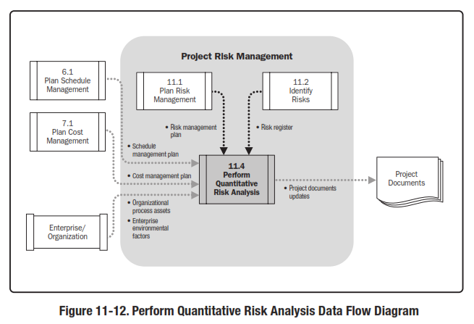
Perform Quantitative Risk Analysis
Reference: Figure 11.12.
PMBOK® Guide, 5th Ed

Slide 32
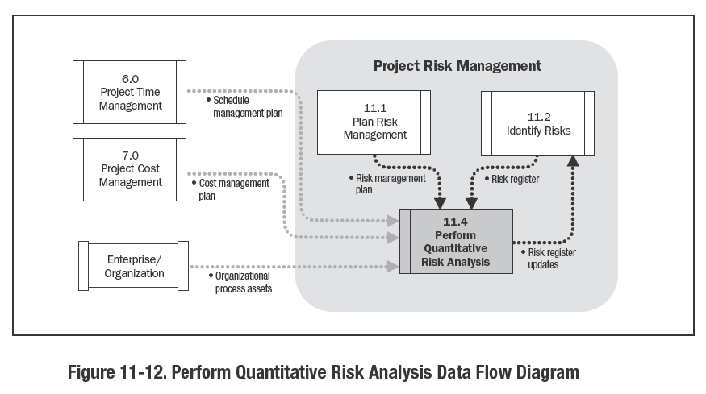
Perform Quantitative Risk Analysis
Reference: Figure 11.12.
PMBOK® Guide, 4th Ed

Slide 33
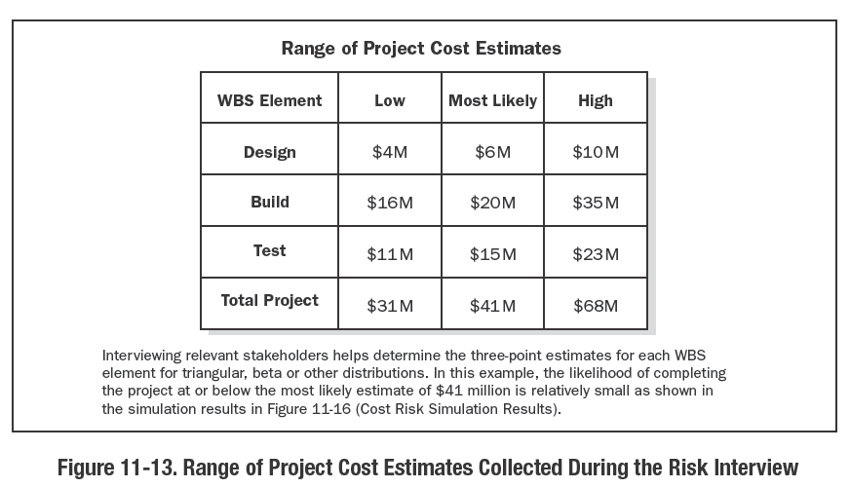

Slide 34
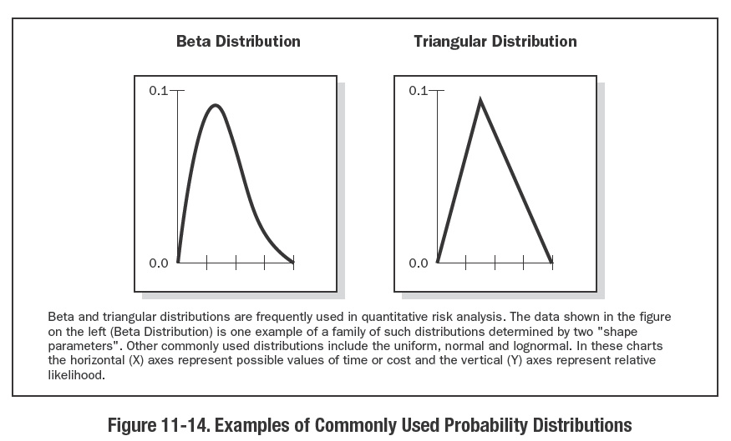

Slide 36
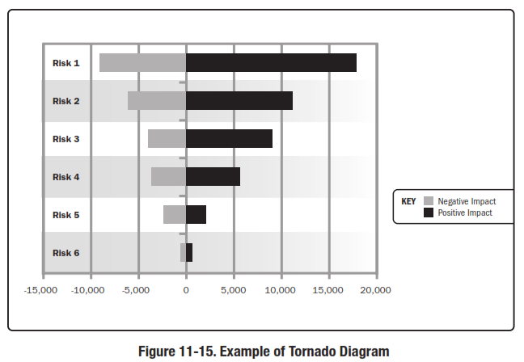

Slide 38
Statistics Definitions
Probability
Likelihood of occurrence. (Number of occurrences of an event divided by the total number of all possible occurrences)
Statistics
Mean – Average of the values of events
Mode – Value which occurs most often
Median – Value in middle of the range of ordered values
Variance
Average of the squared deviations from the mean
Standard deviation – Square Root of the Variance
Range – Values between upper & lower limits

Slide 39
Interviewing
Interviewing – project stakeholders and subject-matter experts to quantify the probability and consequences of risks on project objectives
The information needed depends upon the type of probability distributions that will be used

Slide 40
Probability Distribution
Probability distribution (Method of moments) – Calculates project range estimates
Expected monetary value – Probability times cost
Three values – low (a) , most likely (m), and high (b) – with probabilities for each; used to calculate expected value

Slide 41
Sensitivity & Decision Tree Analysis
Sensitivity Analysis – determines which risks have the most potential impact on the project
Decision Tree Analysis – use of a diagram that describes a decision under consideration and the implications of choosing one or another of the available alternatives
Incorporates probabilities of risks and the costs or rewards of each logical path of events and future decisions
Solving the decision tree indicates which decision yields the greatest expected value when all the uncertain implications, costs, rewards, and subsequent decisions are quantified

Slide 42
Three Point
Three values with probabilities; used to calculate expected values
– Optimistic
– Most likely
– Pessimistic
e.g. Optimistic 0.2 x $ 100 K = $ 20 K
Most Likely 0.6 x $ 130 K = $ 78 K
Pessimistic 0.2 x $ 180 K = $ 36 K
Expected Value = $ 134 K

Slide 43
Decision Tree
Example
0.6
Success
0.5
Project A
Failure
0.4
0.7
0.5
Success
Project B
0.3
Failure
What is the probability that Project B will
be selected and will be successful?
Answer: 0.35

Slide 44
Decision Tree
High Demand
Probability =0.3
$ 550,000
Production Successful
Probability = 0.7
Low Demand
Probability = 0.7
⁻ $100,000
Decide to pursue
Expect Value of Pursuing Project A
0.7 x 0.3 x $ 550,000 = $ 115,500
0.7 x 0.7 x – $ 100,000 = – $ 49,000
0.3 x – $ 200,000 = – $ 60,000
$ 6,500
Production Unsuccessful
Probability = 0.3
Terminate = ⁻ $ 200,000
Decide not to pursue
$ 0
The expected value of Project A is $6,500. The expected value of not preceding is $0. Preceding is the lucrative option.

Slide 45
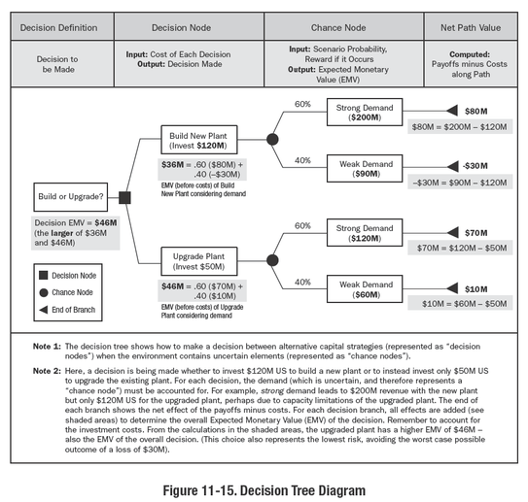

Slide 46
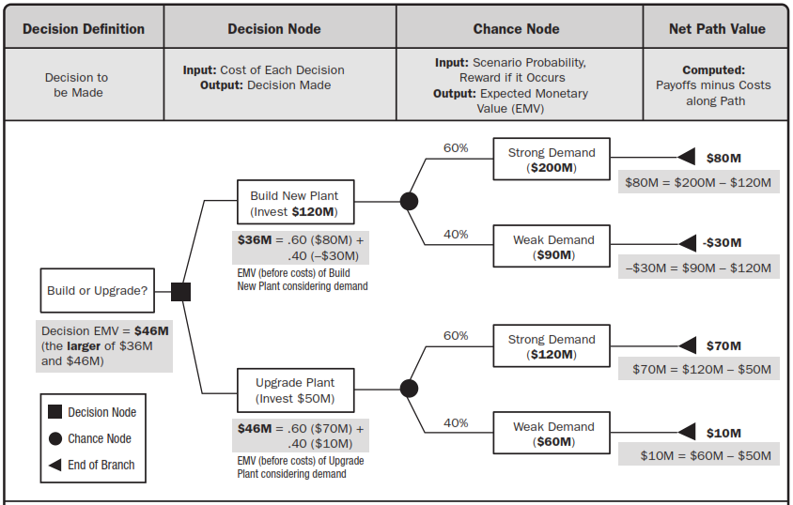

Slide 47
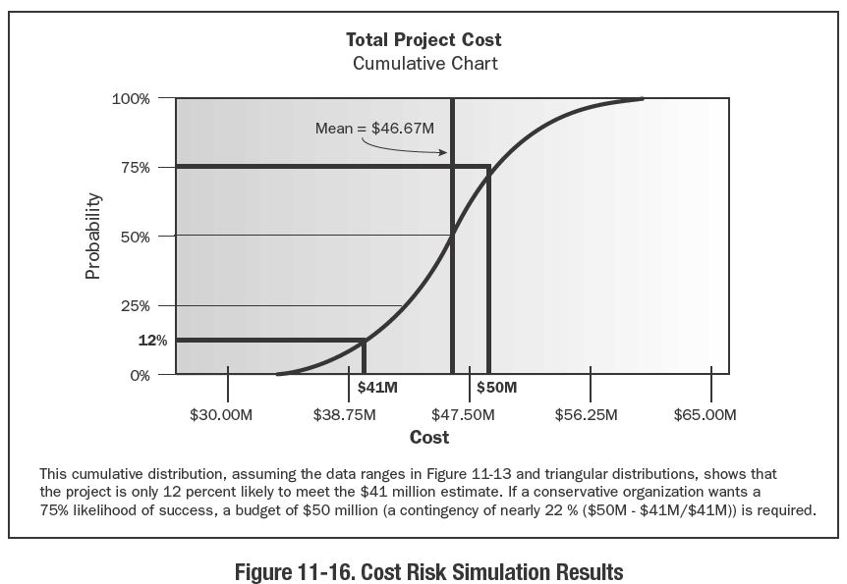

Slide 48
Reference: Figure 11.14.
PMBOK® Guide, 4th Ed

Slide 49
Statistics Beta Distribution
2 standard deviations (+/- 1) = 68.26 %
4 standard deviations (+/- 2) = 95.46 %
6 standard deviations (+/- 3) = 99.73 %
-3
-2
-1
0
+1
+2
+3

Slide 50
Continuous Probability Distribution Triangular Distribution
Probability
30
33
Time
42
There is some probability that the duration could be anywhere from 30 to 42 hours.
Estimate is really a continuous probability distribution or range of probabilities.
Wider the range (standard deviation), more is the uncertainty.
It is called a triangular distribution.
Most likely estimate is not in the middle.

Slide 51
SWOT
Strengths
Weaknesses
Internal
Build On
Eliminate or Reduce
Opportunities
Threats
External
Exploit
Mitigate

Slide 52
Definitions
Probability
Likelihood of occurrence. (Number of occurrences of an event divided by the total number of all possible occurrences)
Statistics
Mean – Average of the values of events
Mode – Value which occurs most often
Median – Value in middle of the range of ordered values
Variance
Average of the squared deviations from the mean
Standard deviation – Square Root of the Variance
Range – Values between upper & lower limits

Slide 53
Interviewing
Interviewing – project stakeholders and subject-matter experts to quantify the probability and consequences of risks on project objectives
The information needed depends upon the type of probability distributions that will be used

Slide 54
Probability and Impact
Best ways to quantitatively come up with probabilities and impacts are:-
Guess at a percentage of probability, or a dollar or time impact using subjective judgment.
Calculate the actual cost and/or time impact.
Use historical records.
Use the Delphi Technique.
Conduct Interviews.

Slide 55
Probability Distribution
Probability distribution (Method of moments) – Calculates project range estimates
Expected monetary value – Probability times cost
Three values – low (a) , most likely (m), and high (b) – with probabilities for each; used to calculate expected value

Slide 56
Expected Monetary Value
To determine what the overall probable circumstance will be as a result of the events.
Expected monetary value is the probability weighted average of all possible outcomes and is calculated as EMV = P x I.
It helps determine which risks need the most attention and should therefore be moved into the Plan Risk Responses process.
EMV is the sum of all quantitative probabilities times their impacts.
Since opportunities are benefits or savings, they are subtracted from the expected monetary value of the threats to come up with the total expected monetary value of the risks.

Slide 57
Sensitivity & Decision Tree Analysis
Sensitivity Analysis – determines which risks have the most potential impact on the project
Decision Tree Analysis – use of a diagram that describes a decision under consideration and the implications of choosing one or another of the available alternatives
Incorporates probabilities of risks and the costs or rewards of each logical path of events and future decisions
Solving the decision tree indicates which decision yields the greatest expected value when all the uncertain implications, costs, rewards, and subsequent decisions are quantified

Slide 58
UNIT 9
PERFORM QUANTITATIVE RISK ANALYSIS
Critical Success Factors

Slide 59
PERFORM QUANTITATIVE RISK ANALYSIS
Critical Success Factors
UNIT 9
7.2.1 Prior Risk Identification and Qualitative Risk Analysis
7.2.2 Appropriate Project Model
7.2.3 Commitment to Collecting High-Quality Risk Data
7.2.4 Unbiased Data
7.2.5 Overall Project Risk Derived from Individual Risks
7.2.6 Interrelationships between Risks in Quantitative Risk Analysis
From Practice Standard for Project Risk Management, 1st Ed, PMI
Notes:
ROLE OF PROJECT RISK MGMT
In Corporate Business Management
Two Basic Types in Corporate Business Management:-
Business Risk
Inherent chances of both profit and loss associated with the particular business endeavor.
Business entities employ skilled staff to increase the chances of profit and reduce the chances of loss.
The essential purpose is to maximize profits.
Pure or Insurable Risk
Involves only a chance for loss and no chance for profit.
Insurable risks can be further sub-divided into four categories:-
Direct property loss
Indirect property loss
Liability loss
Personal loss

Slide 60
PERFORM QUANTITATIVE RISK ANALYSIS
Critical Success Factors
7.2.1 Prior Risk Identification and Qualitative Risk Analysis
UNIT 9
The Perform Quantitative Risk Analysis process occurs after the Identify Risks and Perform Qualitative Risk Analysis processes have been completed.
Reference to a prioritized list of identified risks ensures that the Perform Quantitative Risk Analysis process will consider all significant risks when analyzing their effects quantitatively.
From Practice Standard for Project Risk Management, 1st Ed, PMI
Notes:
ROLE OF PROJECT RISK MGMT
In Corporate Business Management
Two Basic Types in Corporate Business Management:-
Business Risk
Inherent chances of both profit and loss associated with the particular business endeavor.
Business entities employ skilled staff to increase the chances of profit and reduce the chances of loss.
The essential purpose is to maximize profits.
Pure or Insurable Risk
Involves only a chance for loss and no chance for profit.
Insurable risks can be further sub-divided into four categories:-
Direct property loss
Indirect property loss
Liability loss
Personal loss

Slide 61
PERFORM QUANTITATIVE RISK ANALYSIS
Critical Success Factors
7.2.2 Appropriate Project Model
UNIT 9
An appropriate model of the project should be used as the basis for quantitative risk analysis.
Project models most frequently used in quantitative risk analysis include
the project schedule (for time).
Line-item cost estimates (for cost),
Decision tree (for decisions in the face of uncertainty) and
other total-project models.
Quantitative risk analysis is especially sensitive to the completeness and correctness of the model of the project that is used.
From Practice Standard for Project Risk Management, 1st Ed, PMI
Notes:
ROLE OF PROJECT RISK MGMT
In Corporate Business Management
Two Basic Types in Corporate Business Management:-
Business Risk
Inherent chances of both profit and loss associated with the particular business endeavor.
Business entities employ skilled staff to increase the chances of profit and reduce the chances of loss.
The essential purpose is to maximize profits.
Pure or Insurable Risk
Involves only a chance for loss and no chance for profit.
Insurable risks can be further sub-divided into four categories:-
Direct property loss
Indirect property loss
Liability loss
Personal loss

Slide 62
PERFORM QUANTITATIVE RISK ANALYSIS
Critical Success Factors
7.2.3 Commitment to Collecting High-Quality Risk Data
UNIT 9
Often high-quality data about risks are not available in any historic database.
It should be gathered by
interviews,
workshops, and
other means using expert judgment of those present.
Collection of risk data requires resources and time as well as management support.
From Practice Standard for Project Risk Management, 1st Ed, PMI
Notes:
ROLE OF PROJECT RISK MGMT
In Corporate Business Management
Two Basic Types in Corporate Business Management:-
Business Risk
Inherent chances of both profit and loss associated with the particular business endeavor.
Business entities employ skilled staff to increase the chances of profit and reduce the chances of loss.
The essential purpose is to maximize profits.
Pure or Insurable Risk
Involves only a chance for loss and no chance for profit.
Insurable risks can be further sub-divided into four categories:-
Direct property loss
Indirect property loss
Liability loss
Personal loss

Slide 63
PERFORM QUANTITATIVE RISK ANALYSIS
Critical Success Factors
7.2.4 Unbiased Data
UNIT 9
Success in gathering risk analysis data requires the ability to recognize when biases occur and combating that bias or developing other unbiased sources of the data.
Bias in risk data can occur for many reasons, but two common sources of bias are:-
Cognitive bias, and
Motivational bias.
From Practice Standard for Project Risk Management, 1st Ed, PMI
Notes:
ROLE OF PROJECT RISK MGMT
In Corporate Business Management
Two Basic Types in Corporate Business Management:-
Business Risk
Inherent chances of both profit and loss associated with the particular business endeavor.
Business entities employ skilled staff to increase the chances of profit and reduce the chances of loss.
The essential purpose is to maximize profits.
Pure or Insurable Risk
Involves only a chance for loss and no chance for profit.
Insurable risks can be further sub-divided into four categories:-
Direct property loss
Indirect property loss
Liability loss
Personal loss

Slide 64
PERFORM QUANTITATIVE RISK ANALYSIS
Critical Success Factors
7.2.5 Overall Project Risk derived from Individual Risks
UNIT 9
The Perform Quantitative Risk Analysis process is based upon a methodology that correctly derives the overall project risk from the individual risks.
In risk analysis of cost and schedule, e.g., an appropriate method is Monte Carlo simulation.
A decision tree is an appropriate method for making decisions when future events are not certain, using the probability and impact of all risks, and combining their effect to derive an overall project measure such as value or cost.
In each of these methods, the risks are specified at the level of the detailed tasks or line-item costs and incorporated into the model of the project to calculate effects on objectives such as schedule or cost for the entire project, by combining those risks.
From Practice Standard for Project Risk Management, 1st Ed, PMI
Notes:
ROLE OF PROJECT RISK MGMT
In Corporate Business Management
Two Basic Types in Corporate Business Management:-
Business Risk
Inherent chances of both profit and loss associated with the particular business endeavor.
Business entities employ skilled staff to increase the chances of profit and reduce the chances of loss.
The essential purpose is to maximize profits.
Pure or Insurable Risk
Involves only a chance for loss and no chance for profit.
Insurable risks can be further sub-divided into four categories:-
Direct property loss
Indirect property loss
Liability loss
Personal loss

Slide 65
PERFORM QUANTITATIVE RISK ANALYSIS
Critical Success Factors
7.2.6 Interrelationships Between Risks in Quantitative Risk Analysis
UNIT 9
Attention should be given to the possibility that the individual risks in the project model are related to each other.
For example, several risks may have a common root cause and therefore are likely to occur together.
This possibility is sometimes addressed by correlating the risks that are related, ensuring that they generally occur together during the analysis.
Another common way to represent the risks which occur together is by using the risk register listing of the risk or root cause and attaching it to several project elements such as schedule activities or common cost elements.
When a particular risk occurs, the affected elements will all experience the effect of that risk together.
From Practice Standard for Project Risk Management, 1st Ed, PMI
Notes:
ROLE OF PROJECT RISK MGMT
In Corporate Business Management
Two Basic Types in Corporate Business Management:-
Business Risk
Inherent chances of both profit and loss associated with the particular business endeavor.
Business entities employ skilled staff to increase the chances of profit and reduce the chances of loss.
The essential purpose is to maximize profits.
Pure or Insurable Risk
Involves only a chance for loss and no chance for profit.
Insurable risks can be further sub-divided into four categories:-
Direct property loss
Indirect property loss
Liability loss
Personal loss

Slide 66
UNIT 8
PERFORM QUANTITATIVE RISK ANALYSIS
Tools and Techniques

Slide 67
PERFORM QUANTITATIVE RISK ANALYSIS
Tools and Techniques
UNIT 9
7.3.1 Comprehensive Risk Representation
7.3.2 Risk Impact Calculation
7.3.3 Quantitative Method Appropriate to Analyzing Uncertainty
7.3.4 Data Gathering Tools
7.3.5 Effective Presentation of Quantitative Analysis Results
7.3.6 Iterative Quantitative Risk Analysis
7.3.7 Information for response Planning
From Practice Standard for Project Risk Management, 1st Ed, PMI
Notes:
ROLE OF PROJECT RISK MGMT
In Corporate Business Management
Two Basic Types in Corporate Business Management:-
Business Risk
Inherent chances of both profit and loss associated with the particular business endeavor.
Business entities employ skilled staff to increase the chances of profit and reduce the chances of loss.
The essential purpose is to maximize profits.
Pure or Insurable Risk
Involves only a chance for loss and no chance for profit.
Insurable risks can be further sub-divided into four categories:-
Direct property loss
Indirect property loss
Liability loss
Personal loss

Slide 68
PERFORM QUANTITATIVE RISK ANALYSIS
Tools and Techniques
7.3.1 Comprehensive Risk Representation
UNIT 9
Risk models permit representation of many, if not all, of the risks that have impact on an objective simultaneously.
They also permit the representation of both opportunities and threats to the project’s objectives.
From Practice Standard for Project Risk Management, 1st Ed, PMI
Notes:
ROLE OF PROJECT RISK MGMT
In Corporate Business Management
Two Basic Types in Corporate Business Management:-
Business Risk
Inherent chances of both profit and loss associated with the particular business endeavor.
Business entities employ skilled staff to increase the chances of profit and reduce the chances of loss.
The essential purpose is to maximize profits.
Pure or Insurable Risk
Involves only a chance for loss and no chance for profit.
Insurable risks can be further sub-divided into four categories:-
Direct property loss
Indirect property loss
Liability loss
Personal loss

Slide 69
PERFORM QUANTITATIVE RISK ANALYSIS
Tools and Techniques
7.3.2 Risk Impact Calculation
UNIT 9
Quantitative models facilitate the correct calculation of the effect of many risks, which are typically identified and quantified at a level of detail below the total project, on the project objectives, which are typically described at the level of the total project.
From Practice Standard for Project Risk Management, 1st Ed, PMI
Notes:
ROLE OF PROJECT RISK MGMT
In Corporate Business Management
Two Basic Types in Corporate Business Management:-
Business Risk
Inherent chances of both profit and loss associated with the particular business endeavor.
Business entities employ skilled staff to increase the chances of profit and reduce the chances of loss.
The essential purpose is to maximize profits.
Pure or Insurable Risk
Involves only a chance for loss and no chance for profit.
Insurable risks can be further sub-divided into four categories:-
Direct property loss
Indirect property loss
Liability loss
Personal loss

Slide 70
PERFORM QUANTITATIVE RISK ANALYSIS
Tools and Techniques
7.3.3 Quantitative Method Appropriate to Analyzing Uncertainty
UNIT 9
Probability models use a quantitative method that addresses uncertainty.
Specifically, the method should be able to handle the way uncertainty in represented, predominantly as probability of an event’s occurring or as probability distributions for a range of outcomes.
A good example of this is the use of Monte Carlo simulation tools that permit the combination of probability distributions of line-item costs or schedule activity durations. Many of which are uncertain.
From Practice Standard for Project Risk Management, 1st Ed, PMI
Notes:
ROLE OF PROJECT RISK MGMT
In Corporate Business Management
Two Basic Types in Corporate Business Management:-
Business Risk
Inherent chances of both profit and loss associated with the particular business endeavor.
Business entities employ skilled staff to increase the chances of profit and reduce the chances of loss.
The essential purpose is to maximize profits.
Pure or Insurable Risk
Involves only a chance for loss and no chance for profit.
Insurable risks can be further sub-divided into four categories:-
Direct property loss
Indirect property loss
Liability loss
Personal loss

Slide 71
PERFORM QUANTITATIVE RISK ANALYSIS
Tools and Techniques
7.3.4 Data Gathering Tools
UNIT 9
Data Gathering tools used in this process include assessment of historical data and workshops, interviews, or questionnaires to gather quantified information.
For example, on the probability of a risk occurring, a probability distribution of its potential impacts on cost or time, or relationships such as correlation between risks.
From Practice Standard for Project Risk Management, 1st Ed, PMI
Notes:
ROLE OF PROJECT RISK MGMT
In Corporate Business Management
Two Basic Types in Corporate Business Management:-
Business Risk
Inherent chances of both profit and loss associated with the particular business endeavor.
Business entities employ skilled staff to increase the chances of profit and reduce the chances of loss.
The essential purpose is to maximize profits.
Pure or Insurable Risk
Involves only a chance for loss and no chance for profit.
Insurable risks can be further sub-divided into four categories:-
Direct property loss
Indirect property loss
Liability loss
Personal loss

Slide 72
PERFORM QUANTITATIVE RISK ANALYSIS
Tools and Techniques
7.3.5 Effective Presentation of Quantitative Analysis Results
UNIT 9
Results from the quantitative tools are generally not available in standard deterministic project management methods such as project scheduling or cost estimating.
Examples of these are the probability distribution of project completion dates or total costs and the expected value of a project decision.
From Practice Standard for Project Risk Management, 1st Ed, PMI
Notes:
ROLE OF PROJECT RISK MGMT
In Corporate Business Management
Two Basic Types in Corporate Business Management:-
Business Risk
Inherent chances of both profit and loss associated with the particular business endeavor.
Business entities employ skilled staff to increase the chances of profit and reduce the chances of loss.
The essential purpose is to maximize profits.
Pure or Insurable Risk
Involves only a chance for loss and no chance for profit.
Insurable risks can be further sub-divided into four categories:-
Direct property loss
Indirect property loss
Liability loss
Personal loss

Slide 73
PERFORM QUANTITATIVE RISK ANALYSIS
Tools and Techniques
7.3.5 Effective Presentation of Quantitative Analysis Results
UNIT 9
These results, when all risks are considered simultaneously, include the following:-
Probability of achieving a project objective such as finishing on time or within budget.
Amount of contingency reserve in cost, time, or resources needed to provide a required level of confidence.
Identity or location within the project model of the most important risks. An example of this is
a sensitivity analysis in a cost risk analysis or
a criticality analysis in a schedule risk analysis.
From Practice Standard for Project Risk Management, 1st Ed, PMI
Notes:
ROLE OF PROJECT RISK MGMT
In Corporate Business Management
Two Basic Types in Corporate Business Management:-
Business Risk
Inherent chances of both profit and loss associated with the particular business endeavor.
Business entities employ skilled staff to increase the chances of profit and reduce the chances of loss.
The essential purpose is to maximize profits.
Pure or Insurable Risk
Involves only a chance for loss and no chance for profit.
Insurable risks can be further sub-divided into four categories:-
Direct property loss
Indirect property loss
Liability loss
Personal loss

Slide 74
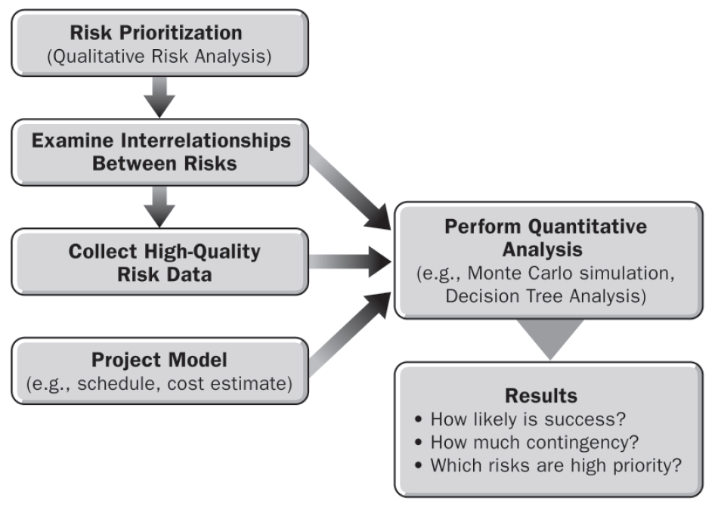
PERFORM QUANTITATIVE RISK ANALYSIS
UNIT 9
From Practice Standard for Project Risk Management, 1st Ed, PMI

Slide 75
PERFORM QUANTITATIVE RISK ANALYSIS
Tools and Techniques
7.3.6 Iterative Quantitative Risk Analysis
UNIT 9
The success of the Perform Quantitative Risk Analysis process is enhanced if the process is used periodically throughout the project.
It is impossible to know in advance all of the risks that may occur in a project.
Often quantitative risk analysis should be repeated as the project proceeds.
The frequency of this effort will be determined during the Plan Risk Management process but will also depend on events within the project itself.
From Practice Standard for Project Risk Management, 1st Ed, PMI
Notes:
ROLE OF PROJECT RISK MGMT
In Corporate Business Management
Two Basic Types in Corporate Business Management:-
Business Risk
Inherent chances of both profit and loss associated with the particular business endeavor.
Business entities employ skilled staff to increase the chances of profit and reduce the chances of loss.
The essential purpose is to maximize profits.
Pure or Insurable Risk
Involves only a chance for loss and no chance for profit.
Insurable risks can be further sub-divided into four categories:-
Direct property loss
Indirect property loss
Liability loss
Personal loss

Slide 76
PERFORM QUANTITATIVE RISK ANALYSIS
Tools and Techniques
7.3.7 Information for Response Planning
UNIT 9
Overall project contingency reserve in time and cost should be reflected in the project’s schedule and budget.
Quantitative risk analysis provides information that may be used to modify the project plan.
If the overall risk to time and cost indicates that an adjustment in scope is needed, the scope changes are agreed upon and documented and a new quantitative risk analysis is carried out to reflect the new aspects of the project.
From Practice Standard for Project Risk Management, 1st Ed, PMI
Notes:
ROLE OF PROJECT RISK MGMT
In Corporate Business Management
Two Basic Types in Corporate Business Management:-
Business Risk
Inherent chances of both profit and loss associated with the particular business endeavor.
Business entities employ skilled staff to increase the chances of profit and reduce the chances of loss.
The essential purpose is to maximize profits.
Pure or Insurable Risk
Involves only a chance for loss and no chance for profit.
Insurable risks can be further sub-divided into four categories:-
Direct property loss
Indirect property loss
Liability loss
Personal loss

Slide 77
UNIT 8
PERFORM QUANTITATIVE RISK ANALYSIS
Documenting the Results

Slide 78
PERFORM QUANTITATIVE RISK ANALYSIS
Documenting the Results
UNIT 9
The contingency reserves calculated in quantitative project cost and schedule risk analysis are incorporated, respectively, into the cost estimate and the schedule to establish a prudent target and a realistic expectation for the project.
Contingency reserves may also be established to provide for the capture of opportunities that are judged to be priorities for the project.
If the contingency reserve required exceeds the time or resources available, changes in the project scope and plan may result.
From Practice Standard for Project Risk Management, 1st Ed, PMI
Notes:
ROLE OF PROJECT RISK MGMT
In Corporate Business Management
Two Basic Types in Corporate Business Management:-
Business Risk
Inherent chances of both profit and loss associated with the particular business endeavor.
Business entities employ skilled staff to increase the chances of profit and reduce the chances of loss.
The essential purpose is to maximize profits.
Pure or Insurable Risk
Involves only a chance for loss and no chance for profit.
Insurable risks can be further sub-divided into four categories:-
Direct property loss
Indirect property loss
Liability loss
Personal loss

Slide 79
PERFORM QUANTITATIVE RISK ANALYSIS
Documenting the Results
UNIT 9
Also, the results of the analysis may provide more or less urgency to risk responses depending on the probability of achieving the plan’s objectives or the amount of contingency reserve required to provide the necessary level of confidence.
The results of a quantitative risk analysis are recorded and passed on to the person and/or group responsible for project management within the organization for any further actions required to make full use of these results.
From Practice Standard for Project Risk Management, 1st Ed, PMI
Notes:
ROLE OF PROJECT RISK MGMT
In Corporate Business Management
Two Basic Types in Corporate Business Management:-
Business Risk
Inherent chances of both profit and loss associated with the particular business endeavor.
Business entities employ skilled staff to increase the chances of profit and reduce the chances of loss.
The essential purpose is to maximize profits.
Pure or Insurable Risk
Involves only a chance for loss and no chance for profit.
Insurable risks can be further sub-divided into four categories:-
Direct property loss
Indirect property loss
Liability loss
Personal loss

Slide 80
UNIT 9
Review Questions

Slide 81
The End
THE END
THANK YOU

